Slide 1
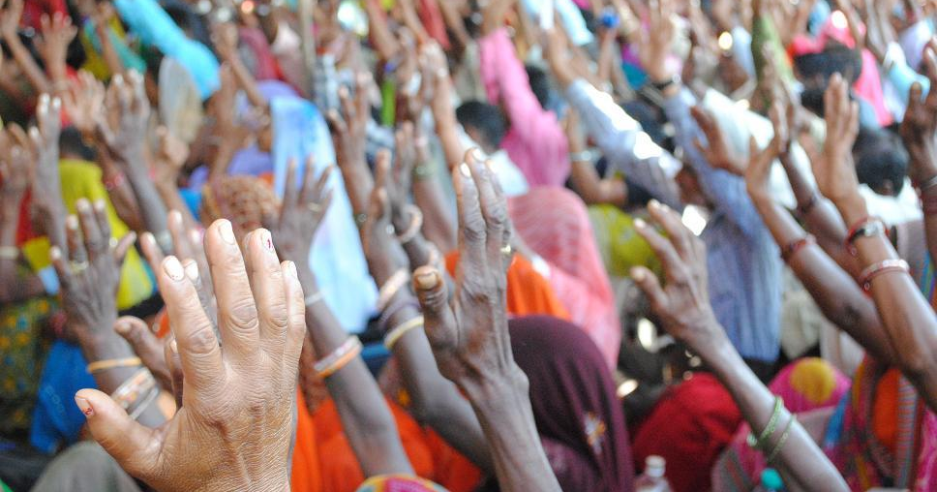
NREGA INSIGHT National Rural Employment Guarantee Act
Presented By: Shiwani A. Kapile
Tableau-Driven Analysis
Mentorness Internship Program

Slide 2

AGENDA
Introduction
Primary goals
Dashboard
Areas of growth
Final Insights

Slide 3

INTRODUCTION
This project analyzes data from the National Rural Employment Guarantee Act (NREGA), a scheme providing rural households with guaranteed wage employment. By examining job cards, workforce, budget, and work completion statistics, we aim to assess NREGA's effectiveness, regional disparities, budget utilization, success factors, and provide insights to optimize its impact.

Slide 4

PRIMARY GOALS
NREGA's effectiveness in rural employment
Factors and roadblocks in work completion
Regional disparities in NREGA implementation
Budget utilization vs. employment generation
Data insights for policy optimization
This Photo by Unknown Author is licensed under CC BY-SA

Slide 5
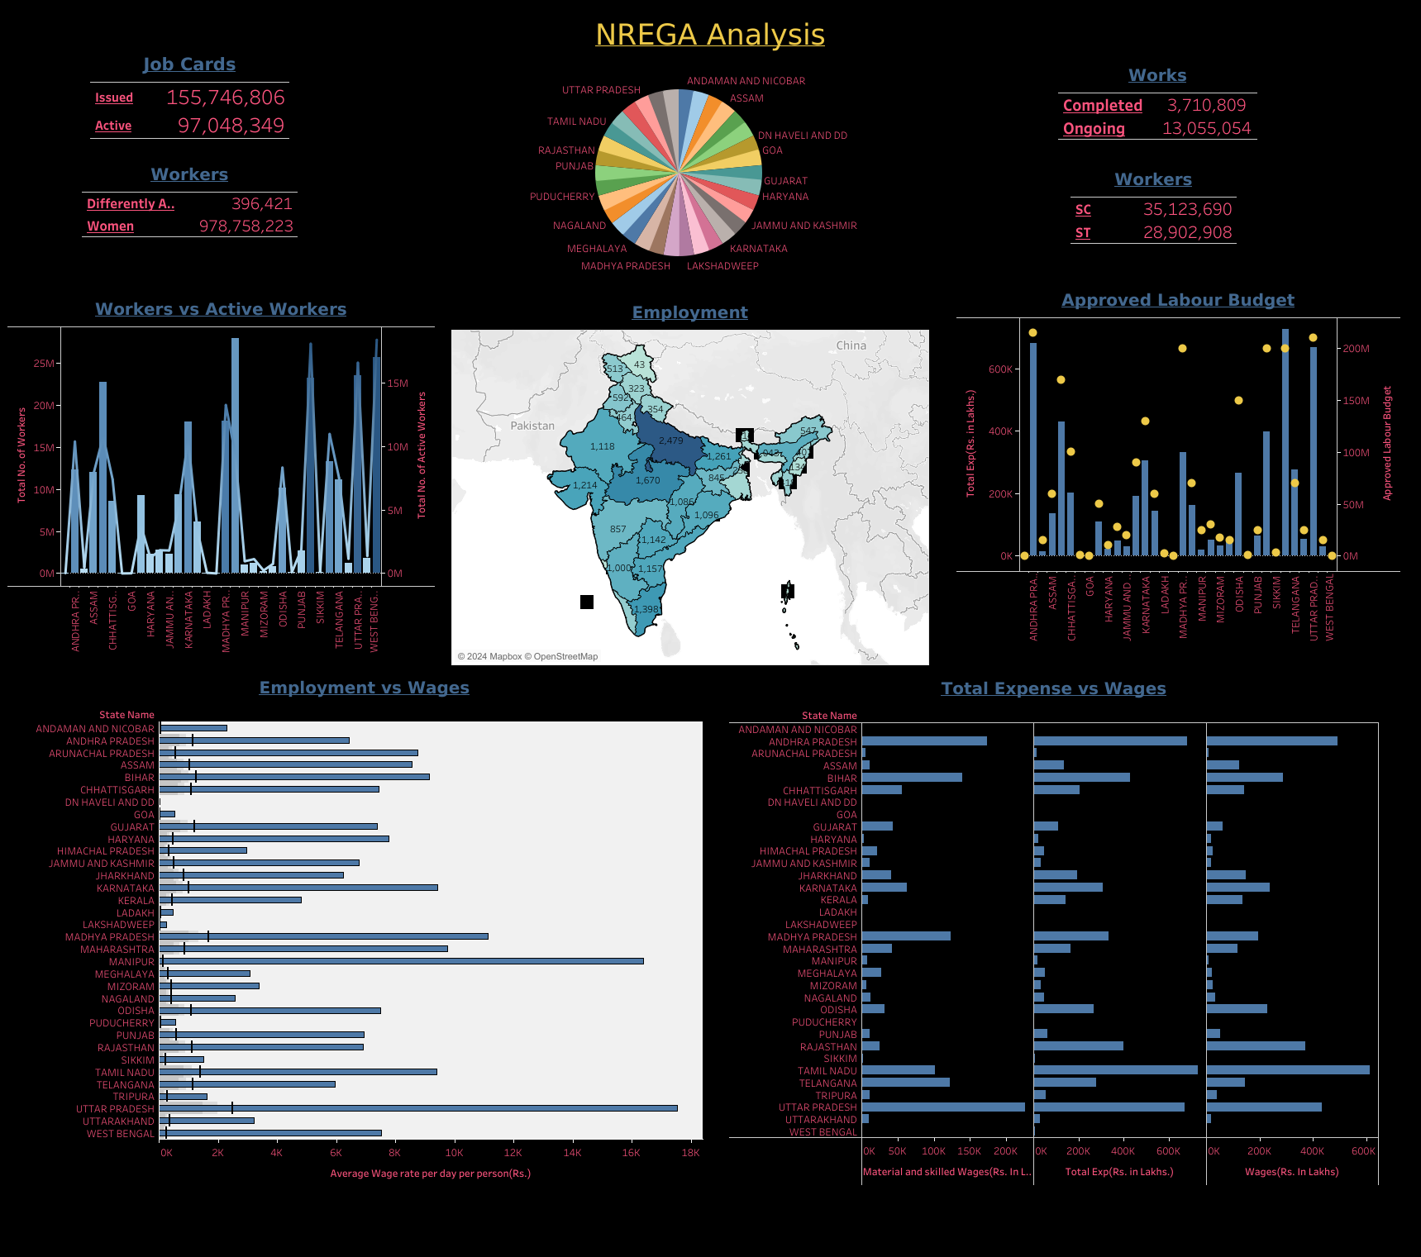
Dashboard Use of Tableau to visualize NREGA data, allows for comprehensive analysis of how effectively employment opportunities are being provided to rural households. The interactive nature of Tableau dashboards enables stakeholders to drill down into specific states or districts, compare various metrics, and gain insights into regional disparities in the implementation and outcomes of the NREGA scheme.

Slide 6
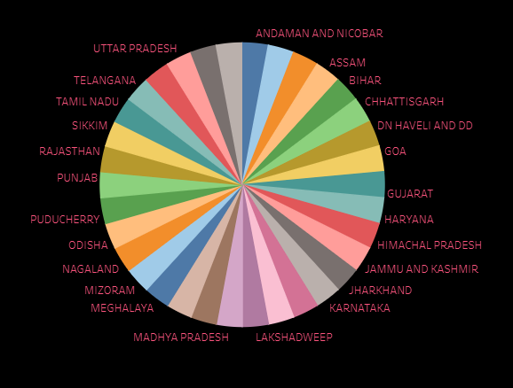
Indian States & Districts

Slide 7

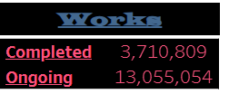
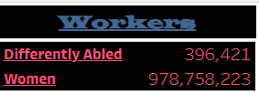
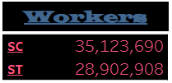
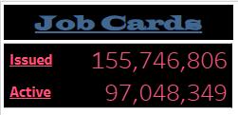

Areas Of Growth

Slide 8
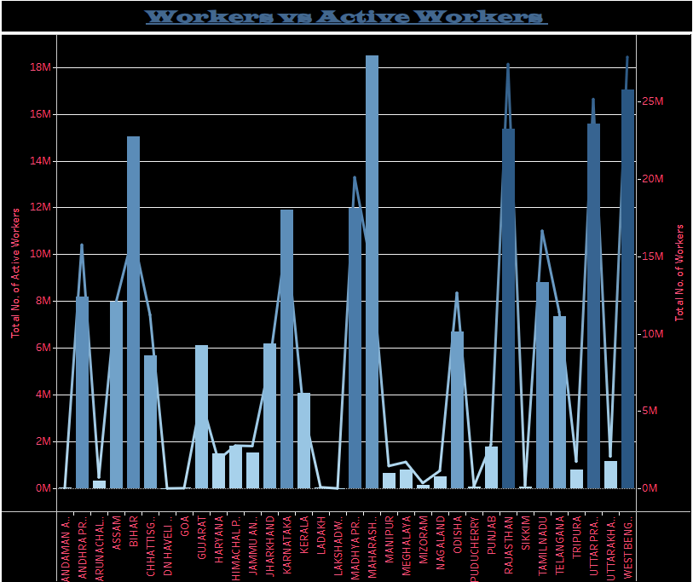
Dual Axes Chart
Legends:
Active Workers: Line
Total Workers: Bar
Axis:
X-Axis: States
Y-Axis (Left): Active Workers
Y-Axis (Right): Total Workers

Slide 9
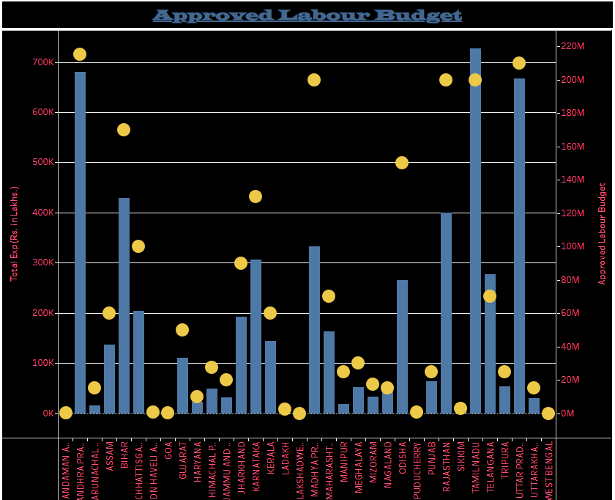
Dual Axes Chart
Marks:
Bar
Circle
Legends:
Total Expense:
Approved Budget:
Axis:
X-Axis: States
Y-Axis (Left): Total Expense
Y-Axis (Right): Approved Budget

Slide 10
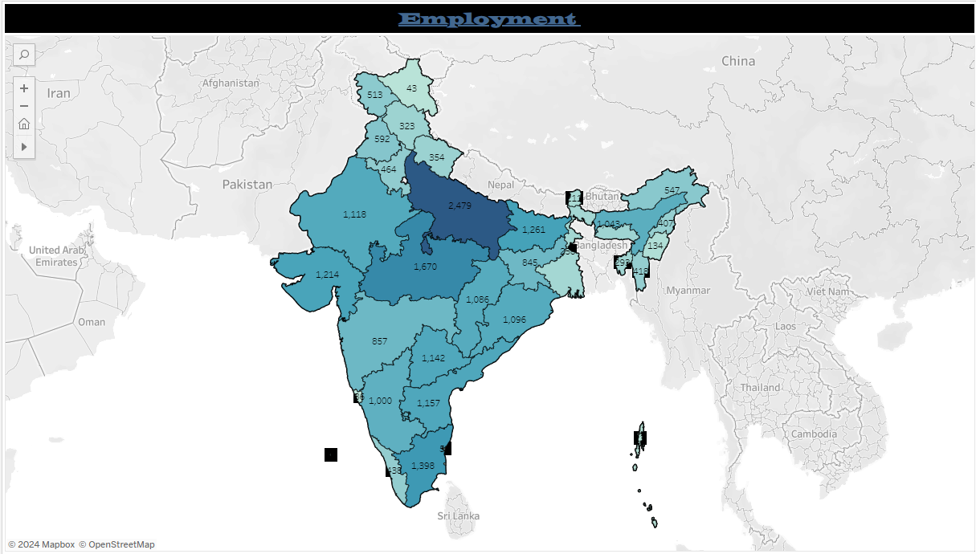
Map Chart
Used a map view to display the total number employees per state.

Slide 11
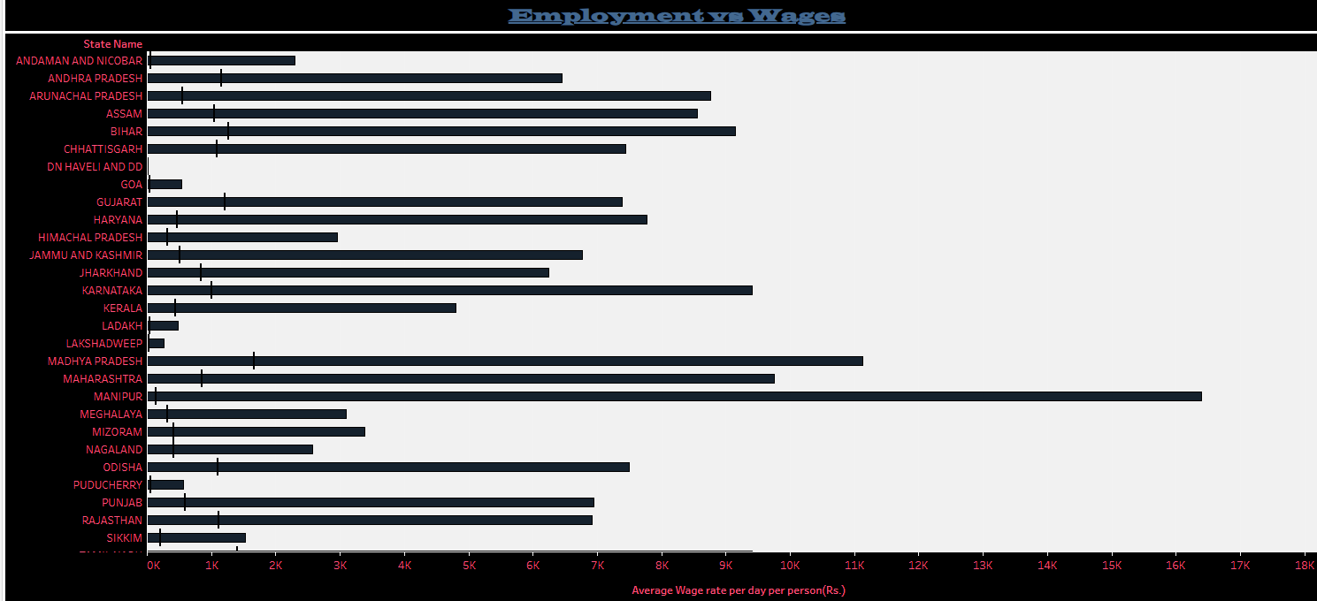
Chart:
Stacked Bar Chart is used to Compare the Average Wages per Person according to each State.

Slide 12
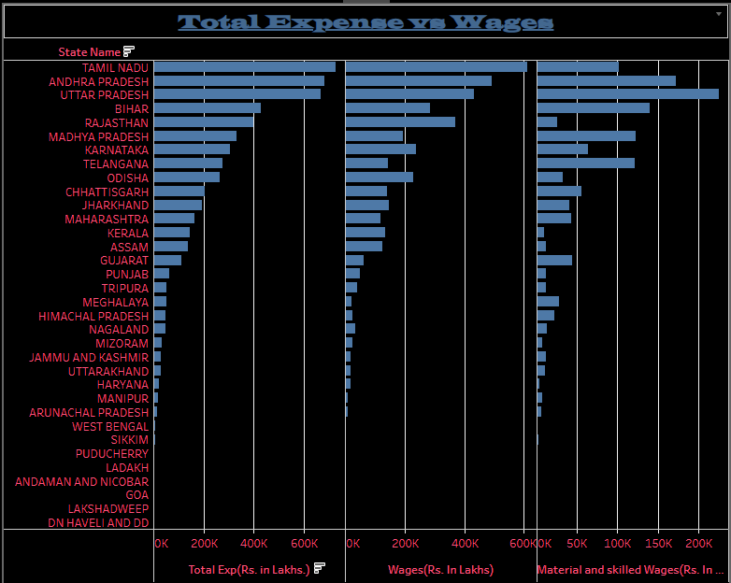
Bar Chart
Marks:
Bar Chart
Axis:
X-Axis 1: Total Expense
X-Axis 2: Wages
X-Axis 3: Material and Skilled Wages
Y-Axis: States

Slide 13

Insights
View: | Result:
Total Issued Job Cards: | 15,57,46,806
Total Active Job Cards: | 97,048,349
Total SC Workers: | 3,51,23,690
Total ST Workers: | 2,89,02,908
Total Women Workers: | 97,87,58,223
Total Differently Abled Workers: | 3,96,421
Total Completed Works: | 37,10,809
Total Ongoing Works | 1,30,55,054

Slide 14
Insights
View: | Result:
Top 3 States With Active Workers: | West Bengal, Rajasthan, Uttar Pradesh
Bottom 3 States With Active Workers: | DN Haveli, Lakshadweep, Goa
Top 3 States With Expense: | Tamil Nadu, Andhra Pradesh, Uttar Pradesh
Bottom 3 States With Expense: | DN Haveli, Lakshadweep, Goa
Top 3 States With Wages: | Tamil Nadu, Andhra Pradesh, Uttar Pradesh
Bottom 3 States With Wages: | DN Haveli, Lakshadweep, Goa
Top 3 States With Employment: | Uttar Pradesh, Tamil Nadu, Gujrat
Bottom 3 States With Employment: | DN Haveli, Lakshadweep, Goa

Slide 15
Thank You If you have any query Email: shriraoshiwani11@gmail.Com Contact no.: 7385944580 Linkedin: https://www.Linkedin.Com/in/shiwani-shrirao-8046471b5/

